Slide 1

2024
Get to Know Me
BALAJI C

Slide 2
2024
Hi, I'm BALAJI C and my strong skills are Devops and Automation around Infrastructure.
Get to Know Me
I learn and continuously update around my tech space, mentor folks, lead and evolve around my deliverables

Slide 3

Bachelors in Electrical Engineering in year 2010
Have 13 years Experience in various fields in IT - ETL, Environment Release Engineer, Devops. Automation and Infrastructure
2024
Educational Background
Get to Know Me

Slide 4

Technical Skills
2024
Get to Know Me
Linux Scripting
Windows Power Shell Scripting
Ansible,
Terraform
Python
Cloud
Devops Complete Tool Tech
AWS, Azure
ELK
SPLUNK

Slide 5

2024
Personal Skills
Get to Know Me
I have good interpersonal skills.
I have a high level of critical thinking.
Problem solving and Mentoring
Continuosly evolve around tech landscape

Slide 6
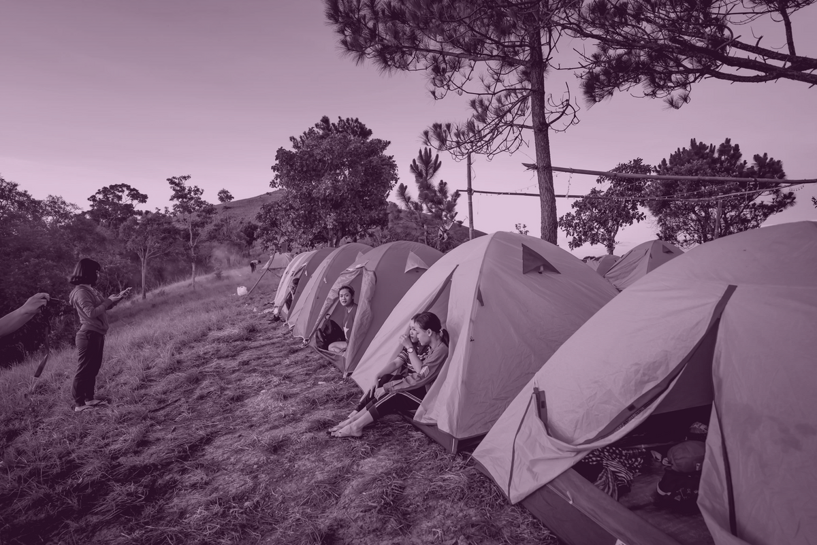
WORK EXPERIENCE
2024
Get to Know Me
AVP, CITICORP SERVICES
Modelled SSHKS Based VM Deployments, Developed & Intergrated with Lightspeed
Developed Playbook Lint Logic Role for lint checks for ansible code.
Developed various playbook for deployment and middleware configs for app teams
Created Various Templates - Golang Build and Deployment Templates for App teams

Slide 7

OTHER MAJOR ACCOMPLISHMENTS
2024
Get to Know Me
Developed and worked on CI-CD setup on application on Cloud
Have Demonstrated experience on Terraform, ELK
Stabilized high critical apps and worked on various Migration setups.
Complete knowledge in full devops suite of tools

Slide 8
2024
Whats Next
Get to Know Me
Learn React and Nodejs
Gain knowledge around LLM, AI’s
Evolve, Seek feedback around leadership space

Slide 9

Hobbies and Interests
2024
Get to Know Me
YOGA
SOUND HEALING
CRICKET
BADMINTON
TECH WORKSHOPS
TRAVEL
MENTORING

Slide 10


2024
Get to Know Me
Contact Information
BALAJI.JUNE20@GMAIL.COM
https://www.linkedin.com/in/bjsizzles/
https://github.com/bjsizzles-g
+91 9940554289
@bjsizzles

